Slide 1

SET Operators

Slide 2

The SET Operators
A
B
A
B
UNION/UNION ALL
A
B
INTERSECT
A
B
MINUS

Slide 3
Tables Used in This Lesson
The tables used in this lesson are
  EMPLOYEES: Provides details regarding all
  current employees
  JOB_HISTORY: Records the details of the start date and end date of the former job, and the job identification number and department when an employee switches jobs

Slide 4
The UNION Operator
A
B
The UNION operator returns results from both queries after eliminating duplications.

Slide 5

Using the UNION Operator
Display the current and previous job details of all employees. Display each employee only once.
SELECT employee_id, job_id
FROM employees
UNION
SELECT employee_id, job_id
FROM job_history;
…
…

Slide 6
The UNION ALL Operator
A
B
The UNION ALL operator returns results from both queries, including all duplications.

Slide 7

Using the UNION ALL Operator
Display the current and previous departments of all employees.
SELECT employee_id, job_id, department_id
FROM employees
UNION ALL
SELECT employee_id, job_id, department_id
FROM job_history
ORDER BY employee_id;
…
…

Slide 8
The INTERSECT Operator
A
B

Slide 9

Using the INTERSECT Operator
Display the employee IDs and job IDs of employees who currently
have a job title that they held before beginning their tenure with the
company.
SELECT employee_id, job_id
FROM employees
INTERSECT
SELECT employee_id, job_id
FROM job_history;

Slide 10
The MINUS Operator
A
B

Slide 11
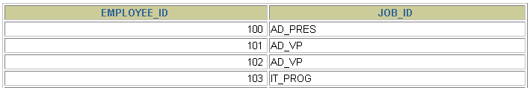

The MINUS Operator
Display the employee IDs of those employees who have not changed their jobs even once.
SELECT employee_id,job_id
FROM employees
MINUS
SELECT employee_id,job_id
FROM job_history;
…

Slide 12
SET Operator Guidelines
The expressions in the SELECT lists must match in number and data type.
Parentheses can be used to alter the sequence of execution.
The ORDER BY clause:
  Can appear only at the very end of the statement
  Will accept the column name, aliases from the first SELECT statement, or the positional notation

Slide 13
The Oracle Server and SET Operators
Duplicate rows are automatically eliminated except in UNION ALL.
Column names from the first query appear in the result.
The output is sorted in ascending order by default except in UNION ALL.

Slide 14
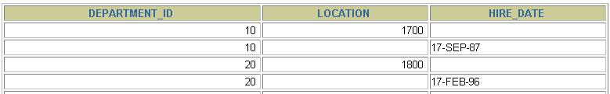

Matching the SELECT Statements
Using the UNION operator, display the department ID, location, and hire date for all employees.
SELECT department_id, TO_NUMBER(null)
location, hire_date
FROM employees
UNION
SELECT department_id, location_id, TO_DATE(null)
FROM departments;
…

Slide 15

Matching the SELECT Statement
Using the UNION operator, display the employee ID, job ID, and salary of all employees.
SELECT employee_id, job_id,salary
FROM employees
UNION
SELECT employee_id, job_id,0
FROM job_history;
…

Slide 16

Controlling the Order of Rows
Produce an English sentence using two UNION operators.
COLUMN a_dummy NOPRINT
SELECT 'sing' AS "My dream", 3 a_dummy
FROM dual
UNION
SELECT 'I''d like to teach', 1
FROM dual
UNION
SELECT 'the world to', 2
FROM dual
ORDER BY 2;

Slide 17

Thank You
World Headquarters
Global Delivery Center
3270 West Big Beaver Road
Troy, MI 48084, U.S.A
Phone : 248.786.2500
Fax : 248.786.2515
E-mail : contact@htcinc.com
Web : www.htcinc.com
SDF II, Phase II
MEPZ, Tambaram
Chennai - 600 045
India
Phone : +91 44 2262 3522
Fax : +91 44 2262 7713

